Slide 1
Number Systems & Operations
Part I

Slide 2
Contents
Decimal Numbers
Binary Numbers
Binary-to-Decimal Conversion
Decimal-to-Binary Conversion

Slide 3
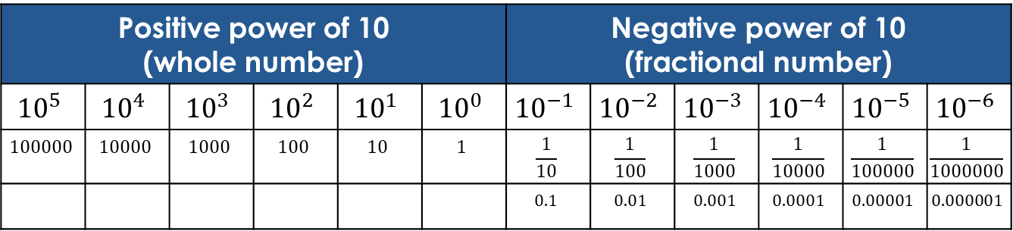
Decimal Numbers (Base 10)
Most commonly used number system
Only 10 digits (0-9) are used to form numbers
The value of a digit is determined by its position in the number and weighting structure of decimal numbers
The weighting structure of decimal numbers:
Positive power of 10 (whole number) |  |  |  |  |  | Negative power of 10 (fractional number)
$${10}^{5}$$ | $${10}^{4}$$ | $${10}^{3}$$ | $${10}^{2}$$ | $${10}^{1}$$ | $${10}^{0}$$ | $${10}^{−1}$$ | $${10}^{−2}$$ | $${10}^{−3}$$ | $${10}^{−4}$$ | $${10}^{−5}$$ | $${10}^{−6}$$
$$100000$$ | $$10000$$ | $$1000$$ | $$100$$ | $$10$$ | $$1$$ | $$\frac{1}{10}$$ | $$\frac{1}{100}$$ | $$\frac{1}{1000}$$ | $$\frac{1}{10000}$$ | $$\frac{1}{100000}$$ | $$\frac{1}{1000000}$$
 |  |  |  |  |  | $$0.1$$ | $$0.01$$ | $$0.001$$ | $$0.0001$$ | $$0.00001$$ | $$0.000001$$

Slide 4
Contents
Decimal Numbers
Binary Numbers
Binary-to-Decimal Conversion
Decimal-to-Binary Conversion

Slide 5
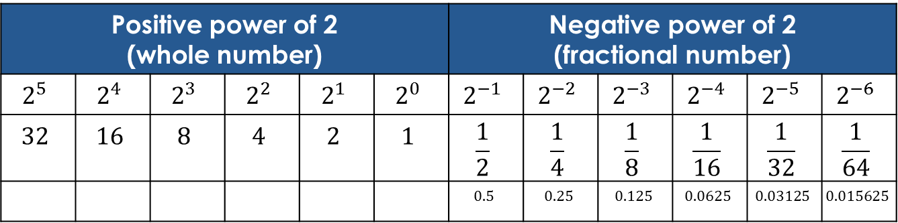
Binary Numbers (Base 2)
Only 2 digits (0 & 1) are used to form numbers
The value of a digit is determined by its position in the number and weighting structure of binary numbers
The weighting structure of binary numbers:
Positive power of 2 (whole number) |  |  |  |  |  | Negative power of 2 (fractional number)
$$2^{5}$$ | $$2^{4}$$ | $$2^{3}$$ | $$2^{2}$$ | $$2^{1}$$ | $$2^{0}$$ | $$2^{−1}$$ | $$2^{−2}$$ | $$2^{−3}$$ | $$2^{−4}$$ | $$2^{−5}$$ | $$2^{−6}$$
$$32$$ | $$16$$ | $$8$$ | $$4$$ | $$2$$ | $$1$$ | $$\frac{1}{2}$$ | $$\frac{1}{4}$$ | $$\frac{1}{8}$$ | $$\frac{1}{16}$$ | $$\frac{1}{32}$$ | $$\frac{1}{64}$$
 |  |  |  |  |  | $$0.5$$ | $$0.25$$ | $$0.125$$ | $$0.0625$$ | $$0.03125$$ | $$0.015625$$

Slide 6
Contents
Decimal Numbers
Binary Numbers
Binary-to-Decimal Conversion
Decimal-to-Binary Conversion

Slide 7
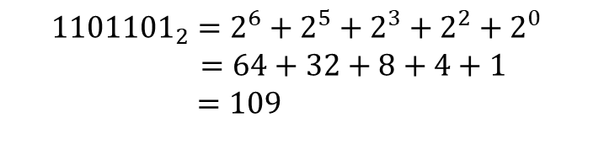

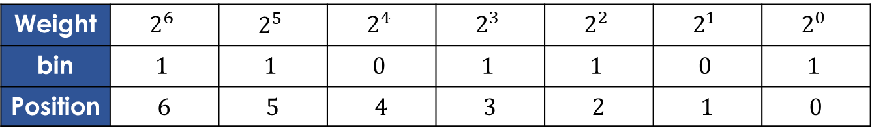
Whole Number
Add the weights of all 1s in a binary number to get the decimal value.
Example: convert ${1101101}_{2}$ to decimal
Weight | $$2^{6}$$ | $$2^{5}$$ | $$2^{4}$$ | $$2^{3}$$ | $$2^{2}$$ | $$2^{1}$$ | $$2^{0}$$
bin | $$1$$ | $$1$$ | $$0$$ | $$1$$ | $$1$$ | $$0$$ | $$1$$
Position | 6 | 5 | 4 | 3 | 2 | 1 | 0
$${1101101}_{2}=2^{6}+2^{5}+2^{3}+2^{2}+2^{0}$$
$=64+32+8+4+1$
$=109$

Slide 8
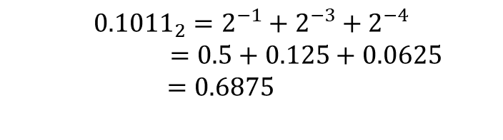

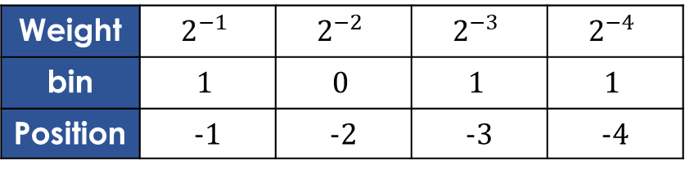
Fractional Number
Fractional binary example
Example: convert ${0.1011}_{2}$ to decimal
Weight | $$2^{−1}$$ | $$2^{−2}$$ | $$2^{−3}$$ | $$2^{−4}$$
bin | $$1$$ | $$0$$ | $$1$$ | $$1$$
Position | -1 | -2 | -3 | -4
$${0.1011}_{2}=2^{−1}+2^{−3}+2^{−4}$$
$=0.5+0.125+0.0625$
$=0.6875$

Slide 9
Contents
Decimal Numbers
Binary Numbers
Binary-to-Decimal Conversion
Decimal-to-Binary Conversion

Slide 10
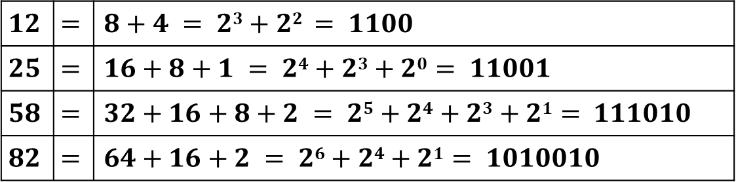

Whole Number
Sum-of-weights method
To get the binary number for a given decimal number, find the binary weights that add up to the decimal number.
Example: convert ${12}_{10}$, ${25}_{10}$, ${58}_{10}$, ${82}_{10}$ to binary
$$12$$ | $$=$$ | $$8+4 = 23+22 = 1100$$
$$25$$ | $$=$$ | $$16+8+1 = 24+23+20 = 11001$$
$$58$$ | $$=$$ | $$32+16+8+2 = 25+24+23+21 = 111010$$
$$82$$ | $$=$$ | $$64+16+2 = 26+24+21 = 1010010$$

Slide 11

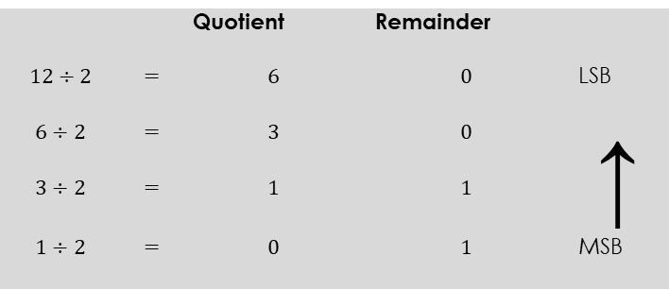


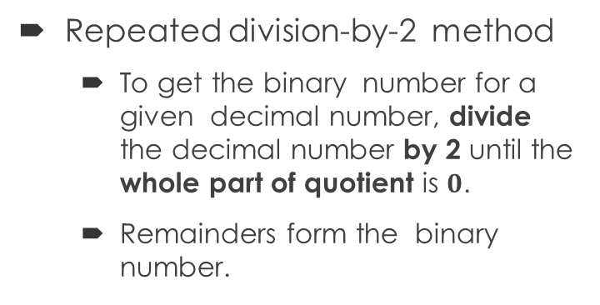
Whole Number
Repeated division-by-2 method
To get the binary number for a given decimal number, divide the decimal number by 2 until the whole part of quotient is $0$.
Remainders form the binary number.
 |  | Quotient | Remainder
$$12÷2$$ | $$=$$ | $$6$$ | $$0$$ | LSB
$$6÷2$$ | $$=$$ | $$3$$ | $$0$$ | ↑
$$3÷2$$ | $$=$$ | $$1$$ | $$1$$
$$1÷2$$ | $$=$$ | $$0$$ | $$1$$ | MSB
Stop when the whole part of quotient is $0$
$${12}_{10}={1100}_{2}$$

Slide 12

Fractional Number
Converting decimal fractions to binary
Sum-of-weights method
This method can be applied to fractional decimal numbers, as shown in the following example:
$0.625=0.5+0.125 =2^{−1}+2^{−3}= 0.101$

Slide 13


Fractional Number
Repeated multiplication by 2
Decimal fraction can be converted to binary by repeated multiplication by 2
Example: convert ${0.3125}_{10}$ to binary
Continue till the desired number of decimal places or stop when the fractional part is all zero.
$${0.3125}_{10}={0.0101}_{2}$$

Slide 14
End of Part I

